Slide 1

Neural Networks

Slide 2

Biological Neural Networks
Models the brain and nervous system
Highly parallel and distributed
Process information
Learning
Very complex behaviours
Consists of 10¹¹ neurons densely connected

Slide 3
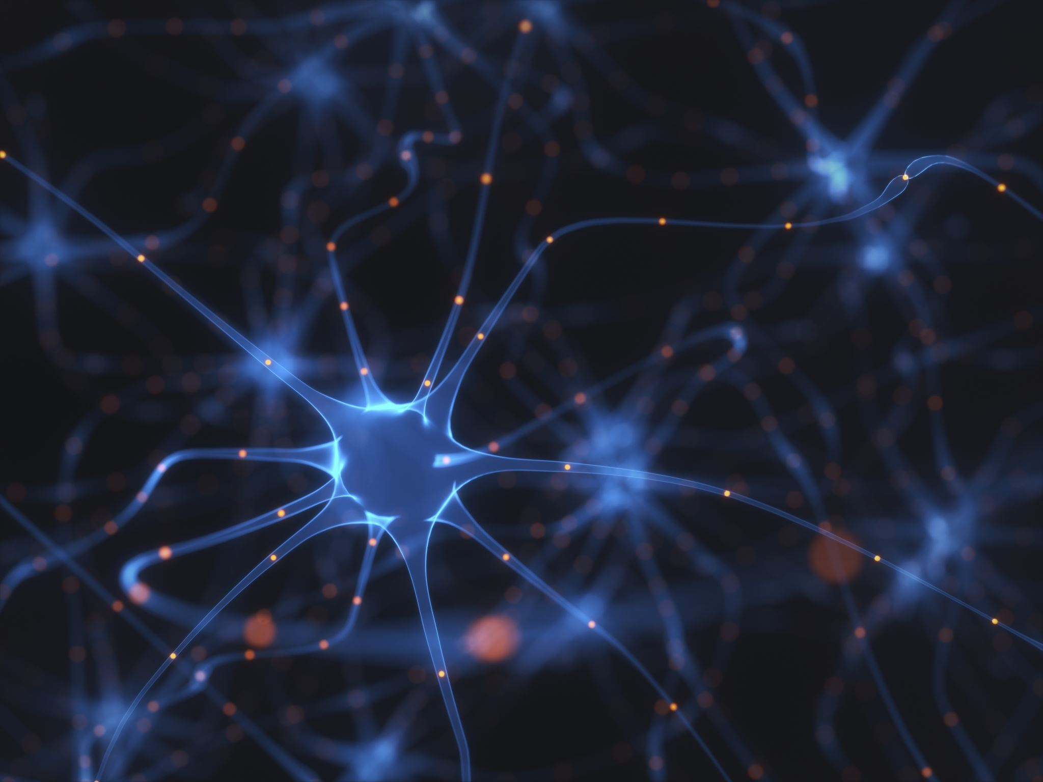
Biological Neural Networks
A variety of different neurons exist (motor neuron, on-center off-surround visual cells…), with different branching structures.
The connections of the network and the strengths of the individual synapses establish the function of the network.

Slide 4
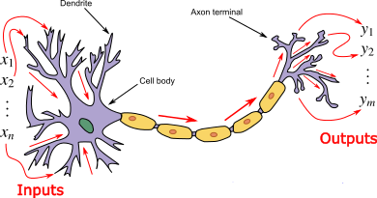
Biological Neurons
Dendrites: nerve fibres carrying electrical signals to the cell
Cell body: computes a non-linear function of its inputs
Axon: single long fiber that carries the electrical signal from the cell body to other neurons
Synapse: the point of contact between the axon of one cell and the dendrite of another, regulating a chemical connection whose strength affects the input to the cell.

Slide 5
Biological Neurons
Signals “move” via electrochemical signals
The synapses release a chemical transmitter – the sum of which can cause a “threshold” to be reached – causing the neuron to “fire”
Synapses can be inhibitory or excitatory

Slide 6
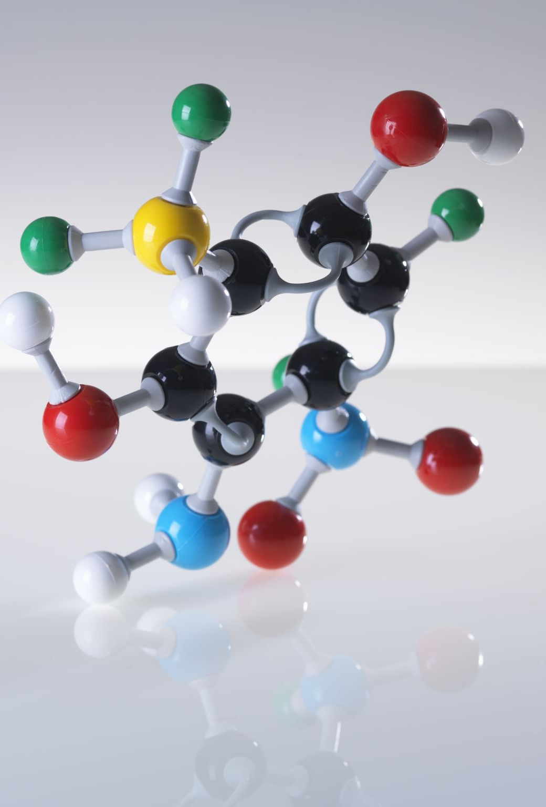
Artificial Neural Networks
Computer algorithms that mimic the biological structures of human brain are formally called Artificial Neural Networks (ANN).
Massively parallel, distributed system, made up of simple processing units (neurons)
Synaptic connection strengths among neurons are used to store the acquired knowledge
Knowledge is acquired by the network from its environment through a learning process

Slide 7
Properties of ANN
Learning from examples – labeled or unlabeled
Adaptivity – changing the connection strengths to learn things
Non-linearity – the non-linear activation functions are essential
Fault tolerance – if one of the neurons or connections is damaged, the whole network still works quite well
Notes:
Thus, they might be better alternatives than classical solutions for problems characterised by: – high dimensionality, noisy, imprecise or imperfect data; and – a lack of a clearly stated mathematical solution or algorithm

Slide 8
History of ANN
McCulloch & Pitts (1943) are generally recognized as the designers of the first neural network
Many of their ideas still used today (e.g. many simple units combine to give increased computational power and the idea of a threshold)
Hebb (1949) developed the first learning rule (on the premise that if two neurons were active at the same time the strength between them should be increased)
Notes:
Thus, they might be better alternatives than classical solutions for problems characterised by: – high dimensionality, noisy, imprecise or imperfect data; and – a lack of a clearly stated mathematical solution or algorithm

Slide 9
History of ANN
During the 50’s and 60’s many researchers worked on the perceptron amidst great excitement.
1969 saw the death of neural network research for about 15 years – Minsky & Papert
Only in the mid 80’s (Parker and LeCun) interest was revived (in fact Werbos discovered algorithm in 1974)
Notes:
Thus, they might be better alternatives than classical solutions for problems characterised by: – high dimensionality, noisy, imprecise or imperfect data; and – a lack of a clearly stated mathematical solution or algorithm

Slide 10
History of ANN
1943: McCulloch and Pitts proposed a model of a neuron --> Perceptron
1960s: Widrow and Hoff explored Perceptron networks (which they called “Adelines”) and the delta rule.
1962: Rosenblatt proved the convergence of the perceptron training rule.
1969: Minsky and Papert showed that the Perceptron cannot deal with nonlinearly-separable data sets---even those that represent simple function such as X-OR.
1970-1985: Very little research on Neural Nets
1986: Invention of Backpropagation [Rumelhart and McClelland, but also Parker and earlier on: Werbos] which can learn from nonlinearly-separable data sets.
Since 1985: A lot of research in Neural Nets!
Notes:
Thus, they might be better alternatives than classical solutions for problems characterised by: – high dimensionality, noisy, imprecise or imperfect data; and – a lack of a clearly stated mathematical solution or algorithm

Slide 11
First ANN
X₁
2
The activation of a neuron is binary. That is, the neuron either fires (activation of one) or does not fire (activation of zero).
X₂
2
Y
-1
X₃
Notes:
Thus, they might be better alternatives than classical solutions for problems characterised by: – high dimensionality, noisy, imprecise or imperfect data; and – a lack of a clearly stated mathematical solution or algorithm

Slide 12
First ANN
X₁
2
For the network shown here the activation function for unit “Y” is:
f(Y) = 1, if Y >= θ else 0
where Y is the total input signal received and θ is the threshold for Y
X₂
2
Y
-1
X₃
Notes:
Thus, they might be better alternatives than classical solutions for problems characterised by: – high dimensionality, noisy, imprecise or imperfect data; and – a lack of a clearly stated mathematical solution or algorithm

Slide 13
First ANN
X₁
2
If the weight on a path is positive the path is excitatory, otherwise it is inhibitory.
X₂
2
Y
-1
X₃
Notes:
Thus, they might be better alternatives than classical solutions for problems characterised by: – high dimensionality, noisy, imprecise or imperfect data; and – a lack of a clearly stated mathematical solution or algorithm

Slide 14
First ANN
X₁
2
Each neuron has a fixed threshold. If the net input into the neuron is greater than the threshold, the neuron fires.
X₂
2
Y
-1
X₃
Notes:
Thus, they might be better alternatives than classical solutions for problems characterised by: – high dimensionality, noisy, imprecise or imperfect data; and – a lack of a clearly stated mathematical solution or algorithm

Slide 15
First ANN
X₁
2
It takes one time step for a signal to pass over one connection.
X₂
2
Y
-1
X₃
Notes:
Thus, they might be better alternatives than classical solutions for problems characterised by: – high dimensionality, noisy, imprecise or imperfect data; and – a lack of a clearly stated mathematical solution or algorithm

Slide 16
Perceptron Model

Slide 17
Perceptron Learning Model
Perceptrons were developed in the 1950s and 1960s by the scientist Frank Rosenblatt, inspired by earlier work by Warren McCulloch and Walter Pitts.
In machine learning, the perceptron is a classification algorithm.
It is a type of linear classifier, i.e. a classification algorithm that makes its predictions based on a linear predictor function combining a set of weights with the feature vector.
Notes:
Thus, they might be better alternatives than classical solutions for problems characterised by: – high dimensionality, noisy, imprecise or imperfect data; and – a lack of a clearly stated mathematical solution or algorithm

Slide 18
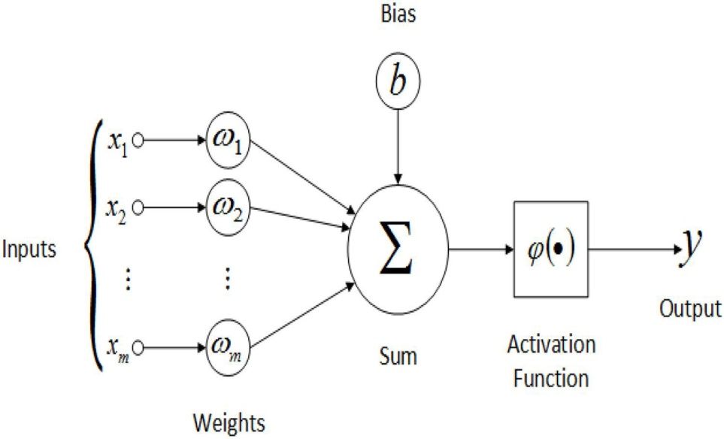
Perceptron Learning Model
A Perceptron takes several real-valued inputs, x1,x2,… and produces a single binary output.
Rosenblatt proposed a simple rule to compute the output. He introduced weights, w1,w2,… real numbers expressing the importance of the respective inputs to the output.
The neuron's output, 0 or 1, is determined by whether the weighted sum ∑_{j}w_{j}x_{j} is less than or greater than some threshold value. Just like the weights, the threshold is a real number which is a parameter of the neuron.
Notes:
Thus, they might be better alternatives than classical solutions for problems characterised by: – high dimensionality, noisy, imprecise or imperfect data; and – a lack of a clearly stated mathematical solution or algorithm

Slide 19
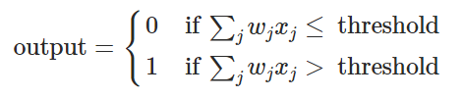

Perceptron Learning Model
To put it in more precise algebraic terms:
Notes:
Thus, they might be better alternatives than classical solutions for problems characterised by: – high dimensionality, noisy, imprecise or imperfect data; and – a lack of a clearly stated mathematical solution or algorithm

Slide 20
Why Bias?
The bias node is a node that is always 'on'. That is, its value is set to 1 without regard for the data in a given pattern.
It is analogous to the intercept in a regression model, and serves the same function.
If a neural network does not have a bias node in a given layer, it will not be able to produce output in the next layer that differs from 0, when the feature values are 0
Notes:
Thus, they might be better alternatives than classical solutions for problems characterised by: – high dimensionality, noisy, imprecise or imperfect data; and – a lack of a clearly stated mathematical solution or algorithm

Slide 21
Why Bias?
Consider a simple example: You have a feed forward perceptron with 2 input nodes A and B, and 1 output node Y.
“A” and “B” are binary features and set as, A=B=0.
Multiply these 2 0’s by whatever weights you like, w_{A} and w_{B}, sum the products and pass it through whatever activation function you prefer. Without a bias node, only one output value is possible, which may yield a very poor fit.
Notes:
Thus, they might be better alternatives than classical solutions for problems characterised by: – high dimensionality, noisy, imprecise or imperfect data; and – a lack of a clearly stated mathematical solution or algorithm

Slide 22

Drawback of Perceptron Model

Slide 23
Perceptron Limitation
Suppose if we make a small change in some weight (or bias) in the network. What we'd like is - for this small change in weight to cause only a small corresponding change in the output from the network.
The problem is that this isn't what happens when our network contains perceptrons. In fact, a small change in the weights or bias of any single perceptron in the network can sometimes cause the output of that perceptron to completely flip, say from 0 to 1.
Notes:
Thus, they might be better alternatives than classical solutions for problems characterised by: – high dimensionality, noisy, imprecise or imperfect data; and – a lack of a clearly stated mathematical solution or algorithm

Slide 24
Perceptron Limitation
We can overcome this problem by introducing a new type of artificial neuron called a sigmoid neuron.
Sigmoid neurons are similar to perceptrons, but modified so that small changes in their weights and bias cause only a small change in their output.
Notes:
Thus, they might be better alternatives than classical solutions for problems characterised by: – high dimensionality, noisy, imprecise or imperfect data; and – a lack of a clearly stated mathematical solution or algorithm

Slide 25

Sigmoid Neuron
Also just like a perceptron, the sigmoid neuron has weights for each input, w1,w2,… and an overall bias, b. But the output is not 0 or 1. Instead, it's σ(w⋅x+b) and σ is called the sigmoid function (Activation Function or Transfer Function).
Notes:
Thus, they might be better alternatives than classical solutions for problems characterised by: – high dimensionality, noisy, imprecise or imperfect data; and – a lack of a clearly stated mathematical solution or algorithm

Slide 26
Similarity b/w Perceptron & Sigmoid Neuron
Suppose z=w.x+b is a large positive number. Then e^{−z}≈0 and so σ(z)≈1. In other words, when z=w.x+b is large and positive, the output from the sigmoid neuron is approximately 1, just as it would have been for a perceptron.
Suppose on the other hand that z=w.x+b is very negative. Then e^{−z}→∞, and σ(z)≈0. So when z=w.x+b very negative, the behaviour of a sigmoid neuron also closely approximates a perceptron.
Notes:
Thus, they might be better alternatives than classical solutions for problems characterised by: – high dimensionality, noisy, imprecise or imperfect data; and – a lack of a clearly stated mathematical solution or algorithm

Slide 27
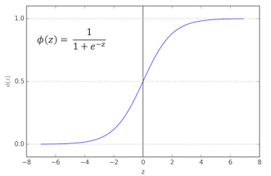
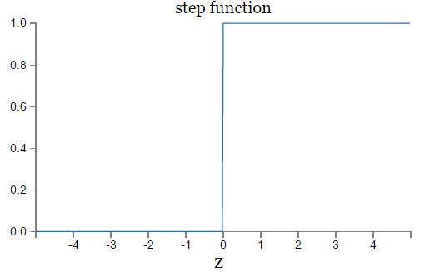
Algebraic Form of Sigmoid & Perceptron Functions
Sigmoid Function
Step Function
Notes:
Thus, they might be better alternatives than classical solutions for problems characterised by: – high dimensionality, noisy, imprecise or imperfect data; and – a lack of a clearly stated mathematical solution or algorithm

Slide 28
Activation Functions

Slide 29
Activation Functions
In computational network, activation function of a node defines the output of that node given the input or the set of inputs.
It can be as simple as a step function that turns the neuron output on and off, depending on a rule or threshold. Or it can be a transformation that maps the input signals into output signals that are needed for the neural network to function.
Notes:
Thus, they might be better alternatives than classical solutions for problems characterised by: – high dimensionality, noisy, imprecise or imperfect data; and – a lack of a clearly stated mathematical solution or algorithm

Slide 30
Activation Functions
Increasingly, neural networks use non-linear activation functions, which can help the network learn complex data, compute and learn almost any function representing a question, and provide accurate predictions.
Notes:
Thus, they might be better alternatives than classical solutions for problems characterised by: – high dimensionality, noisy, imprecise or imperfect data; and – a lack of a clearly stated mathematical solution or algorithm

Slide 31
Activation Functions
Types of Activation Functions
Step-wise function
Linear Activation Function
Non-Linear Activation Functions
Notes:
Thus, they might be better alternatives than classical solutions for problems characterised by: – high dimensionality, noisy, imprecise or imperfect data; and – a lack of a clearly stated mathematical solution or algorithm

Slide 32
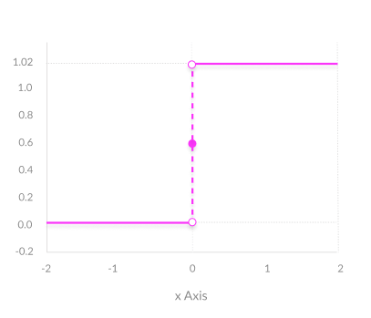
Step-wise Activation Function
A binary step function is a threshold-based activation function. If the input value is above or below a certain threshold, the neuron is activated and sends exactly the same signal to the next layer.
The problem with a step function is that it does not allow multi-value outputs—for example, it cannot support classifying the inputs into one of several categories.
Notes:
Thus, they might be better alternatives than classical solutions for problems characterised by: – high dimensionality, noisy, imprecise or imperfect data; and – a lack of a clearly stated mathematical solution or algorithm

Slide 33
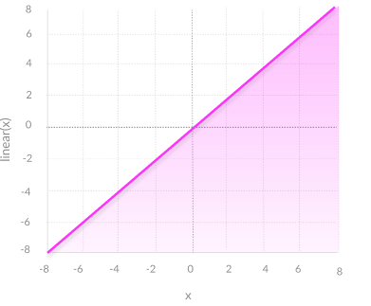
Linear Activation Function
A linear activation function takes the form: A = cx
It takes the inputs, multiplied by the weights for each neuron, and creates an output signal proportional to the input.
In one sense, a linear function is better than a step function because it allows multiple outputs, not just yes and no.
Notes:
Thus, they might be better alternatives than classical solutions for problems characterised by: – high dimensionality, noisy, imprecise or imperfect data; and – a lack of a clearly stated mathematical solution or algorithm

Slide 34
Linear Activation Function
A neural network with a linear activation function is simply a linear regression model. It has limited power and ability to handle complexity varying parameters of input data.
Notes:
Thus, they might be better alternatives than classical solutions for problems characterised by: – high dimensionality, noisy, imprecise or imperfect data; and – a lack of a clearly stated mathematical solution or algorithm

Slide 35
Non_Linear Activation Functions

Slide 36
Non-Linear Activation Function
Modern neural network models use non-linear activation functions.
They allow the model to create complex mappings between the network’s inputs and outputs, which are essential for learning and modeling complex data, such as images, video, audio, and data sets which are non-linear or have high dimensionality.
Notes:
Thus, they might be better alternatives than classical solutions for problems characterised by: – high dimensionality, noisy, imprecise or imperfect data; and – a lack of a clearly stated mathematical solution or algorithm

Slide 37
Non-Linear Activation Function
Non-linear functions address the problems of a linear activation function:
They allow backpropagation because they have a derivative function which is related to the inputs.
They allow “stacking” of multiple layers of neurons to create a deep neural network. Multiple hidden layers of neurons are needed to learn complex data sets with high levels of accuracy.
Notes:
Thus, they might be better alternatives than classical solutions for problems characterised by: – high dimensionality, noisy, imprecise or imperfect data; and – a lack of a clearly stated mathematical solution or algorithm

Slide 38
Common Non-Linear Activation Functions
Sigmoid / Logistic
TanH / Hyperbolic Tangent
ReLU ( Rectified Linear Unit)
Leaky ReLU
Parametric ReLU
Softmax
Notes:
Thus, they might be better alternatives than classical solutions for problems characterised by: – high dimensionality, noisy, imprecise or imperfect data; and – a lack of a clearly stated mathematical solution or algorithm

Slide 39
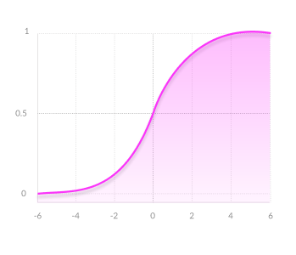
Sigmoid Function
Output values bound between 0 and 1, normalizing the output of each neuron.
Clear predictions—For X above 2 or below -2, tends to bring the Y value (the prediction) to the edge of the curve, very close to 1 or 0. This enables clear predictions.
Notes:
Thus, they might be better alternatives than classical solutions for problems characterised by: – high dimensionality, noisy, imprecise or imperfect data; and – a lack of a clearly stated mathematical solution or algorithm

Slide 40
Disadvantages of Sigmoid Function
Vanishing gradient—for very high or very low values of X, there is almost no change to the prediction, causing a vanishing gradient problem. This can result in the network refusing to learn further, or being too slow to reach an accurate prediction.
Outputs not zero centred
Computationally expensive
Notes:
Thus, they might be better alternatives than classical solutions for problems characterised by: – high dimensionality, noisy, imprecise or imperfect data; and – a lack of a clearly stated mathematical solution or algorithm

Slide 41
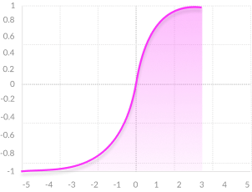
TanH Function
Zero centered—making it easier to model inputs that have strongly negative, neutral, and strongly positive values.
Otherwise like the Sigmoid function.
Notes:
Thus, they might be better alternatives than classical solutions for problems characterised by: – high dimensionality, noisy, imprecise or imperfect data; and – a lack of a clearly stated mathematical solution or algorithm

Slide 42
TanH Function
Vanishing gradient—for very high or very low values of X, there is almost no change to the prediction, causing a vanishing gradient problem. This can result in the network refusing to learn further, or being too slow to reach an accurate prediction.
Computationally expensive
Notes:
Thus, they might be better alternatives than classical solutions for problems characterised by: – high dimensionality, noisy, imprecise or imperfect data; and – a lack of a clearly stated mathematical solution or algorithm

Slide 43
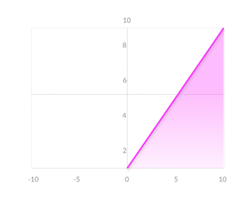
ReLU Function
Computationally efficient—allows the network to converge very quickly
Non-linear—although it looks like a linear function, ReLU has a derivative function and allows for backpropagation
Notes:
Thus, they might be better alternatives than classical solutions for problems characterised by: – high dimensionality, noisy, imprecise or imperfect data; and – a lack of a clearly stated mathematical solution or algorithm

Slide 44
ReLU Function
The Dying ReLU problem—when inputs approach zero, or are negative, the gradient of the function becomes zero, the network cannot perform backpropagation and cannot learn.
Notes:
Thus, they might be better alternatives than classical solutions for problems characterised by: – high dimensionality, noisy, imprecise or imperfect data; and – a lack of a clearly stated mathematical solution or algorithm

Slide 45
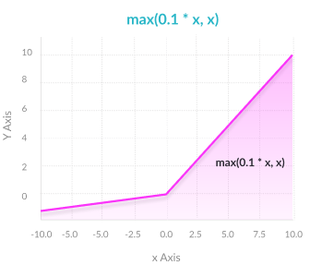
Leaky ReLU Function
Prevents dying ReLU problem— this variation of ReLU has a small positive slope in the negative area, so it does enable backpropagation, even for negative input values
Otherwise like ReLU
Notes:
Thus, they might be better alternatives than classical solutions for problems characterised by: – high dimensionality, noisy, imprecise or imperfect data; and – a lack of a clearly stated mathematical solution or algorithm

Slide 46
Leaky ReLU Function
Results not consistent—leaky ReLU does not provide consistent predictions for negative input values.
Notes:
Thus, they might be better alternatives than classical solutions for problems characterised by: – high dimensionality, noisy, imprecise or imperfect data; and – a lack of a clearly stated mathematical solution or algorithm

Slide 47
Softmax Function
Able to handle multiple classes only one class in other activation functions—normalizes the outputs for each class between 0 and 1, and divides by their sum, giving the probability of the input value being in a specific class.
Useful for output neurons—typically Softmax is used only for the output layer, for neural networks that need to classify inputs into multiple categories.
Notes:
Thus, they might be better alternatives than classical solutions for problems characterised by: – high dimensionality, noisy, imprecise or imperfect data; and – a lack of a clearly stated mathematical solution or algorithm

Slide 48
Feedforward Neural Network

Slide 49
Feedforward Neural Network
Also called as Multi-layer Perceptron
A multilayer perceptron (MLP) is a group of perceptrons, organized in multiple layers, that can accurately answer complex questions.
Each perceptron in the first layer sends signals to all the perceptrons in the second layer, and so on. An MLP contains an input layer, at least one hidden layer, and an output layer.
Notes:
Thus, they might be better alternatives than classical solutions for problems characterised by: – high dimensionality, noisy, imprecise or imperfect data; and – a lack of a clearly stated mathematical soluti kiiiiiiiiiiiiiiiiiiiiiiiiiiiiiiiiiiiiiiiiiiiiiiiiiiiiiit65son or algorithm

Slide 50
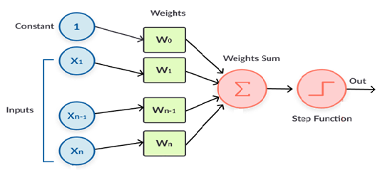
FNN Architecture
The leftmost layer in this network is called the input layer,
The rightmost or output layer contains the output neurons, or, as in this case, a single output neuron.
The middle layer is called a hidden layer, since the neurons in this layer are neither inputs nor outputs.

Slide 51
Training FNN
Training a neural network basically means calibrating all of the “weights” by repeating two key steps:
forward propagation
back propagation

Slide 52
Training FNN
In forward propagation, we apply a set of weights to the input data and calculate an output. For the first forward propagation, the set of weights is selected randomly.
In back propagation, we measure the margin of error of the output and adjust the weights accordingly to decrease the error.
Neural networks repeat both forward and back propagation until the weights are calibrated to accurately predict an output.

Slide 53
Backpropagation

Slide 54
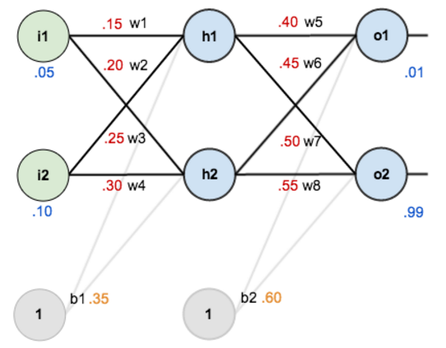
With two feature input, weights and bias values

Slide 55
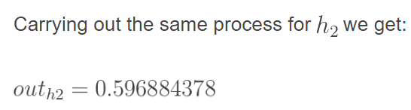
Forward Pass – Hidden Layer
net_{h1} = w₁ * i₁ + w₂ * i₂ + b₁ * 1
net_{h1} = 0.15 * 0.05 + 0.2 * 0.1 + 0.32 * 1 = 0.3775
Passing net_{h1} through sigmoid function, gives the output of h1, out_{h1}
net_{h1}
out_{h1}

Slide 56

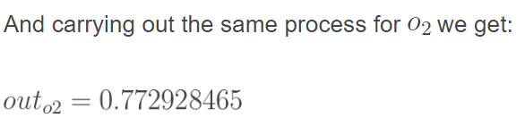
Forward Pass – Output Layer
net_{o1} = w₅ * out_{h1} + w₆ * out_{h2} + b₂ * 1
net_{o1} = 0.4 * 0.593269992 + 0.45 * 0.596884378 + 0.6 * 1 = 1.105905967
Passing net_{o1} through sigmoid function, gives the output of o1, out_{o1}
net_{o1}
out_{o1}

Slide 57


Calculating the total Error
Calculate the total error for each output neuron using the squared error function and sum them to get the total error:
Note: The ½ is included so that exponent is cancelled when we differentiate later on. The result is eventually multiplied by a learning rate anyway so it doesn’t matter that we introduce a constant here

Slide 58
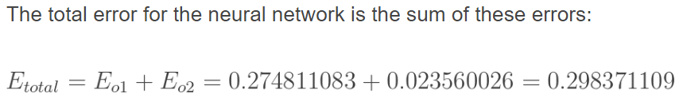
Total Error
The total error for the neural network is the sum of theses errors:

Slide 59

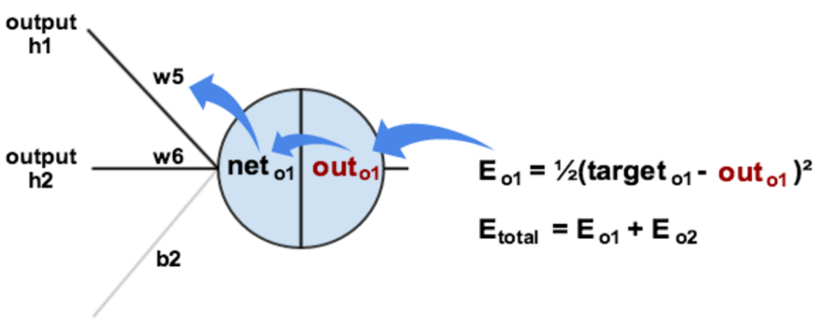
Backward Pass- Actual Learning
Now consider weight w₅. We want how much change in w₅, affects the total error term
By applying the chain rule, we get:

Slide 61
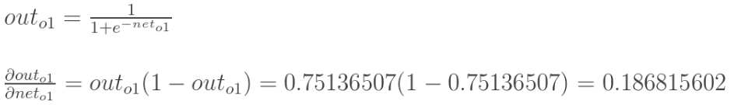

Slide 62

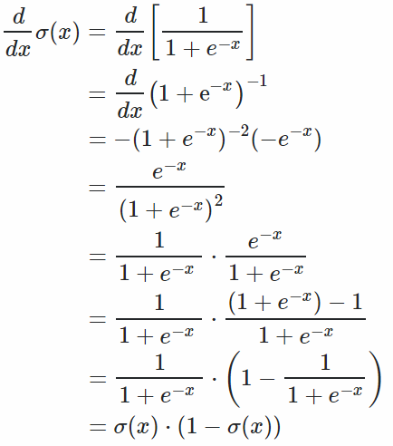
Derivative of sigmoid function

